Slide 1



Waste Classification Using
CNN

Slide 2

Learning Objectives
Understand CNN – Learn how CNNs process image data for waste plastic classification.
Data Preprocessing – Explore image acquisition, resizing, normalization, and augmentation.
CNN Architecture – Study convolution, pooling layers, and hyperparameters for effective classification.
Model Training – Train CNNs using backpropagation, optimization (SGD, Adam), and loss functions.
Performance Evaluation – Analyze accuracy, precision, recall, F1-score, and confusion matrix.
Deployment– Integrate the trained model into real-world waste management systems.
GOAL
Source :
www.freepik.com/

Slide 3


Tools and Technology used
Programming Language – Python (preferred for deep learning and image processing).
Deep Learning Frameworks – TensorFlow, Keras, or PyTorch for building and training CNN models.
Image Processing Libraries – OpenCV and PIL for preprocessing, augmentation, and feature extraction.
Dataset Management – Kaggle Datasets, Google Drive, or local storage for handling waste plastic images.
Development Environment – Jupyter Notebook, Google Colab, or VS Code for coding and experimentation.
Hardware Acceleration – GPU (NVIDIA CUDA) or cloud platforms like Google Colab, AWS, or Azure for faster training.
Performance Analysis Tools – Matplotlib, Seaborn, and TensorBoard for model evaluation and visualization.

Slide 4
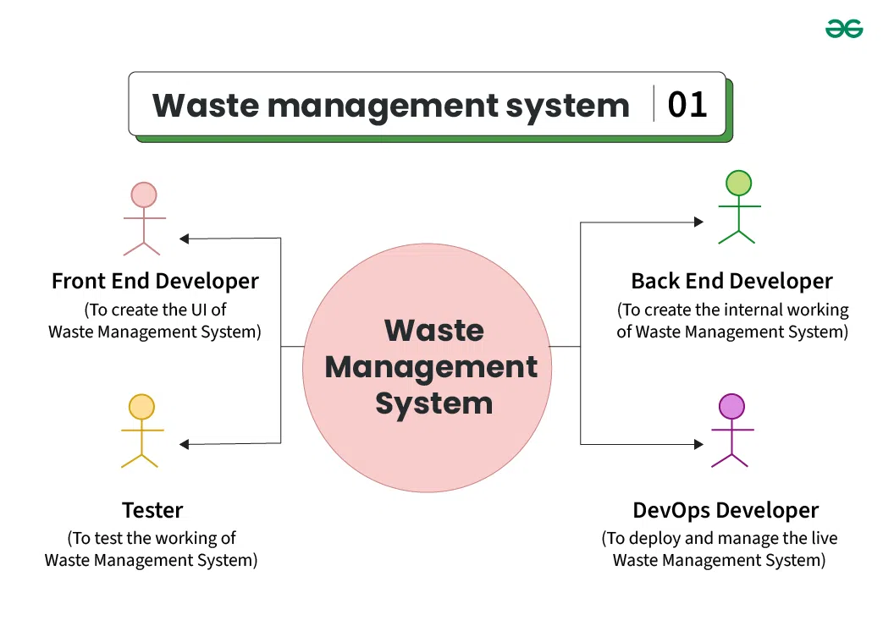
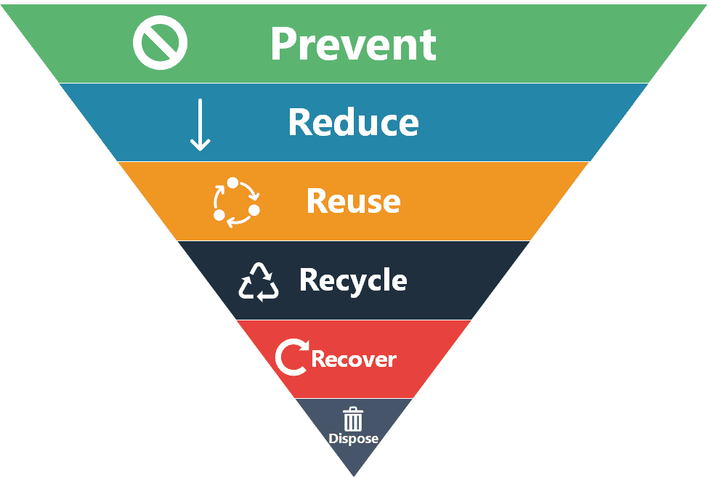
Methodology
Problem Definition – Define the goal of classifying waste plastic types using CNNs.
Data Collection & Preprocessing– Gather images, clean, resize, normalize, and apply data augmentation.
Model Design – Develop a CNN architecture with convolutional, pooling, and fully connected layers.
Model Training– Train the CNN using labeled data, optimizing with techniques like Adam or SGD.
Evaluation & Validation – Use accuracy, precision, recall, F1-score, and confusion matrix to assess performance.
Hyperparameter Tuning – Optimize learning rate, batch size, and number of layers for better accuracy.
Deployment – Deploy the trained model using Flask, TensorFlow Serving, or an edge device for real-world application.

Slide 5
Problem Statement:
Plastic waste is a major environmental concern, contributing to pollution and harming ecosystems. Efficient sorting and recycling require accurate classification of different types of plastic waste. Traditional methods rely on manual sorting, which is time-consuming and error-prone. This project aims to develop a Convolutional Neural Network (CNN)-based model to automate the classification of waste plastic images. By leveraging deep learning, the system will enhance accuracy, speed, and efficiency in waste management, supporting sustainable recycling efforts and reducing environmental impact.

Slide 6
The solution involves:
Data Collection & Preprocessing – Gathering a dataset of waste plastic images, applying resizing, normalization, and data augmentation.
CNN Model Development – Designing and training a CNN with optimized layers to extract features and classify plastic types accurately.
Model Training & Optimization – Using techniques like *Adam optimizer, dropout, and batch normalization* to enhance performance.
Evaluation & Validation – Measuring accuracy, precision, recall, F1-score, and confusion matrix to assess classification performance.
Deployment & Integration – Deploying the trained model via Flask API, TensorFlow Serving, or edge devices for real-world applications in smart waste management systems.
Solution:

Slide 7
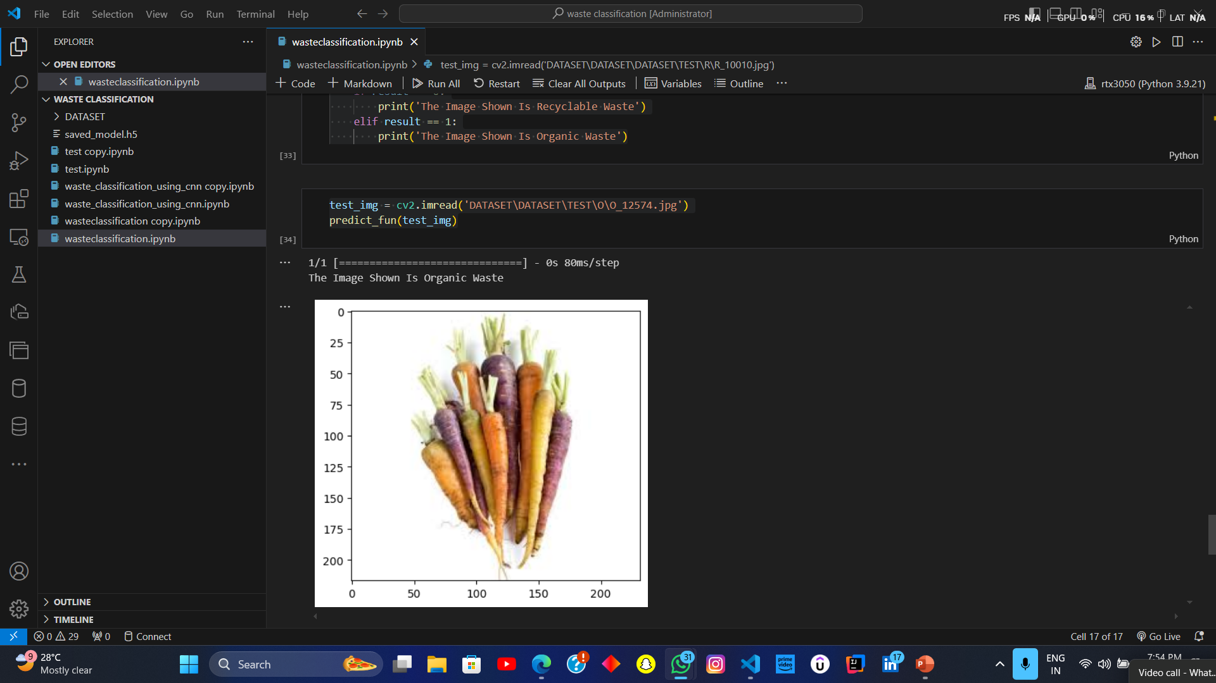
Screenshot of Output:

Slide 8

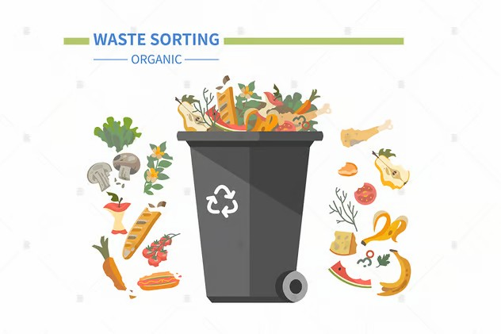
Conclusion:
The CNN-based waste plastic classification model provides an efficient and automated approach to sorting plastic waste, addressing the limitations of manual classification. By leveraging deep learning, the system enhances accuracy, speed, and scalability, making waste management more effective. The trained model can be deployed in recycling plants, waste management facilities, and smart cities, contributing to environmental sustainability. Future improvements may include expanding the dataset, integrating IoT sensors for real-time classification, and optimizing the model for edge devices. This project demonstrates the potential of AI in promoting efficient recycling and reducing plastic pollution.

